Slide 1
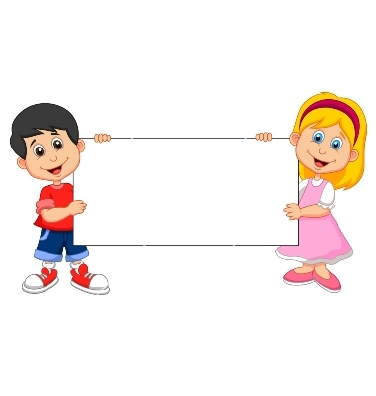

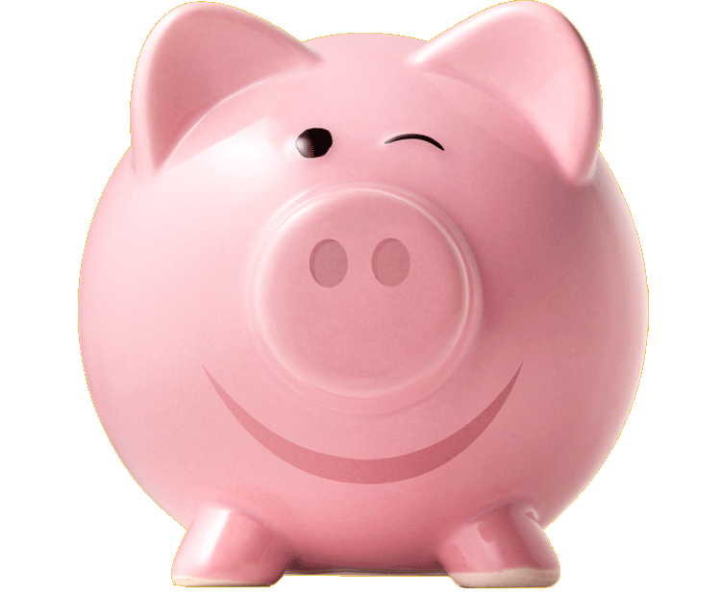
Donation
(Unwilling Piggybank)

Slide 2
Boys Version
Familiarization Task

Slide 3
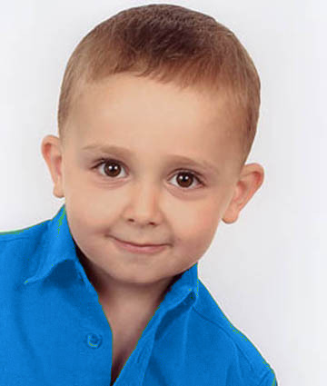
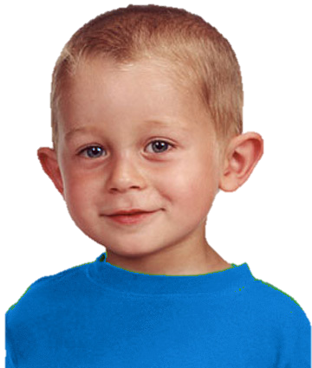
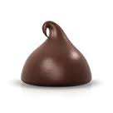
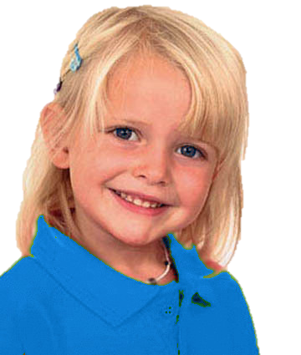
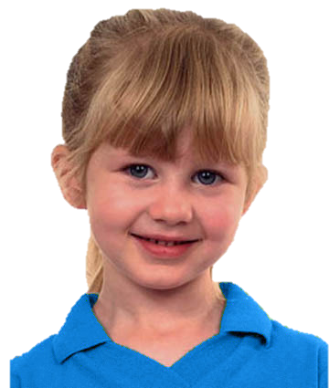
Introduce the group & the piggybank

Slide 4
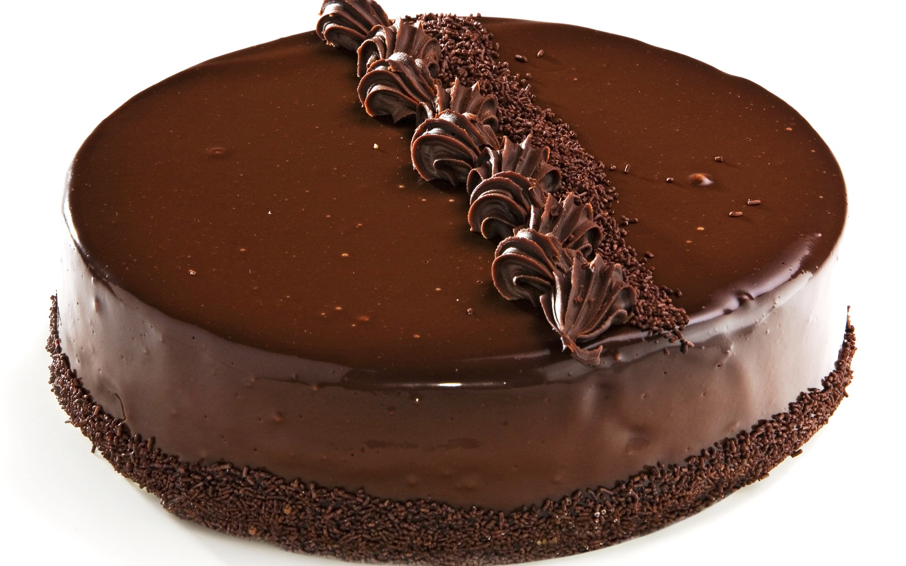
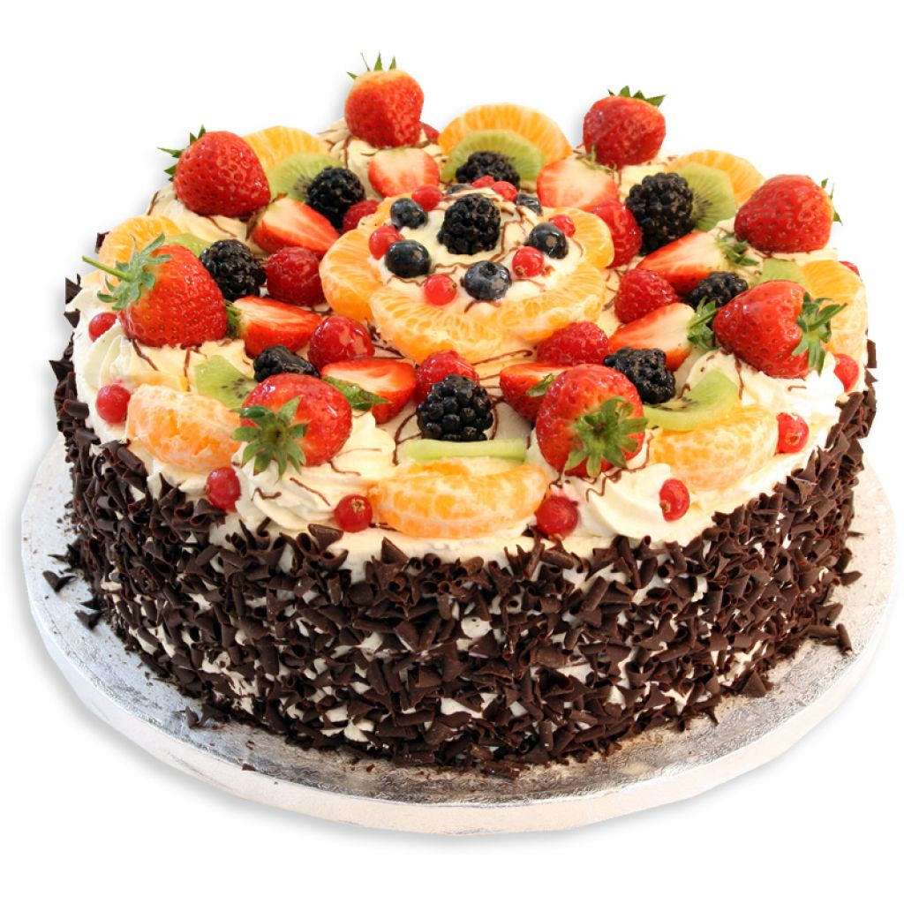
Explain how the piggybank works

Slide 5
Questions & feedback

Slide 6
Test Task

Slide 7
The group goal: have a big cake and share it

Slide 8
Unwilling free-rider (upper left):
Doesn’t want to put his chocolate into the piggybank; he eats it

Slide 9
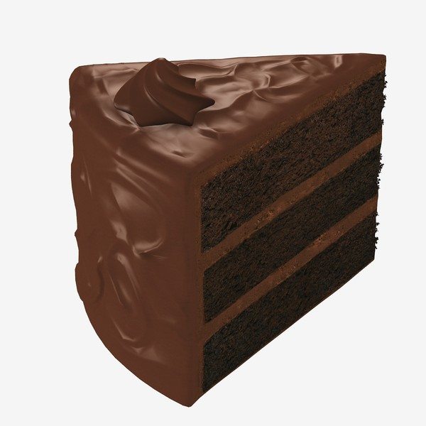
The outcome
The outcome: The piggy bank makes a small cake. Each kid gets a piece of it.

Slide 10
Test Questions
F
C

Slide 11
Contributor Reminder:
Wanted to put his chocolate into the piggybank and put it there.

Slide 12

Evaluation: is he good or bad?

Slide 13
Evaluation: a little good/bad or really good/bad?

Slide 14


Preference: Do you like him or you don’t like him?

Slide 15


Preference: do you like him a little or a lot? do you kind of don’t like him or really don’t like him?
To Free-Rider

Slide 16
Unwilling Free-Rider Reminder:
Didn’t want to put his chocolate into the piggybank and ate it.

Slide 17
Evaluation: is he good or bad?

Slide 18
Evaluation: a little good/bad or really good/bad?

Slide 19
Preference: Do you like him or you don’t like him?

Slide 20
Preference: do you like him a little or a lot? do you kind of don’t like him or really don’t like him?
To Contributor

Slide 21
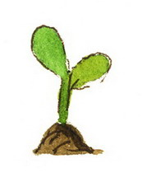
Donation
(Unable Plant)

Slide 22
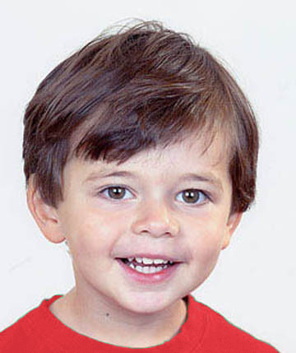
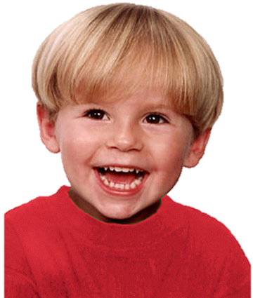
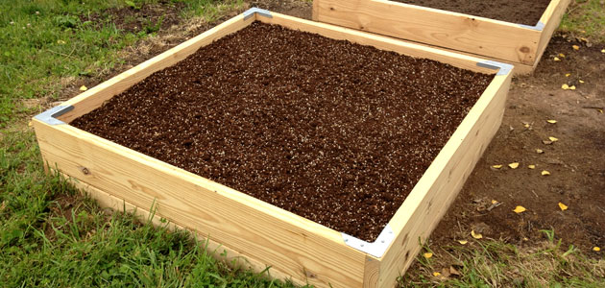
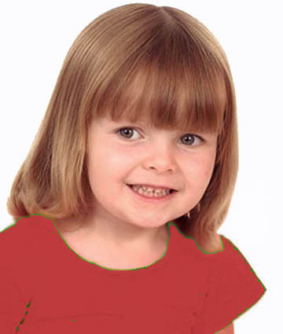
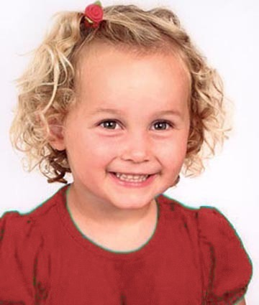
Introduce the group & the garden

Slide 23
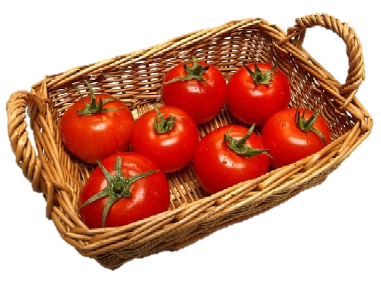
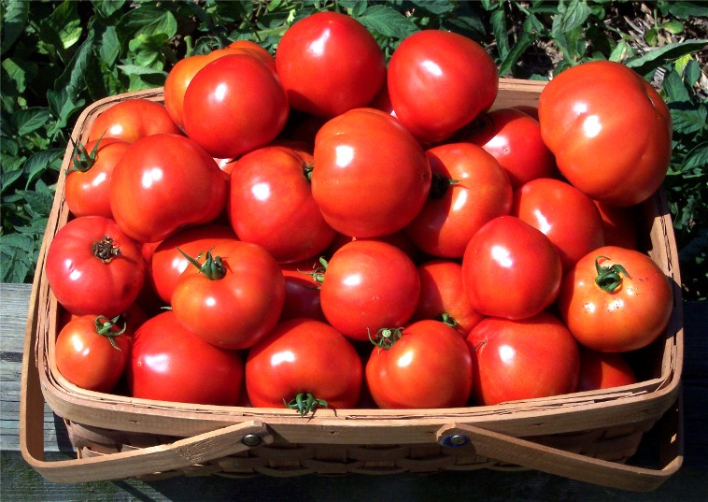
Explain how the garden works

Slide 24
Questions & Feedback

Slide 25
Test Task

Slide 26
The group goal: have a big basket of tomatoes and share them

Slide 27
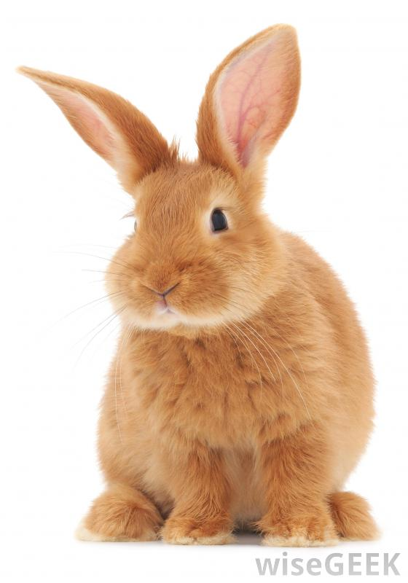
The boy (on the upper right corner) wants to put his plant in the group garden, but a rabbit comes to eat his plant. The other children put their plants into the garden.
Notes:
The boy (on the upper right corner) wants to put his plant in the group garden,
but a rabbit comes to eat his plant

Slide 28
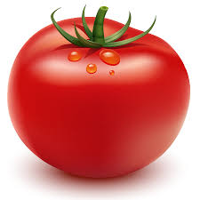

The outcome: They get a small basket of tomatoes. Each kid gets a tomato.

Slide 29
Test Questions
F
C

Slide 30
Test Questions
Contributor

Slide 31
Contributor Reminder:
Wanted to put his plant in the garden and put it there.

Slide 32
Evaluation: is he good or bad?

Slide 33
Evaluation: a little good/bad or really good/bad?

Slide 34
Preference: Do you like him or you don’t like him?

Slide 35
Preference: do you like him a little or a lot? do you kind of don’t like him or really don’t like him?
To Free-Rider

Slide 36
Unable Free-Rider Reminder:
Wanted to put his plant in the garden but a rabbit ate it.

Slide 37
Evaluation: is he good or bad?

Slide 38
Evaluation: a little good/bad or really good/bad?

Slide 39
Preference: Do you like him or you don’t like him?

Slide 40
Preference: do you like him a little or a lot? do you kind of don’t like him or really don’t like him?
To Contributor

